Slide 1
Tracking Automation Effectiveness in DevOps
This project aims to analyze and measure how automation improves efficiency, reliability, and scalability in DevOps workflows.
Presented By:
Gowri S K
Nandan Kumar
Mohan D T
Nithin N M

Slide 2
The Promise of DevOps Automation: Efficiency, Reliability, Scale
Efficiency
Reliability
Scalability
Automate repetitive tasks, freeing up valuable time for innovation and problem-solving.
Reduce human error and ensure consistent results through automated processes.
Effortlessly handle increased workloads and demands with automated infrastructure and workflows.

Slide 3
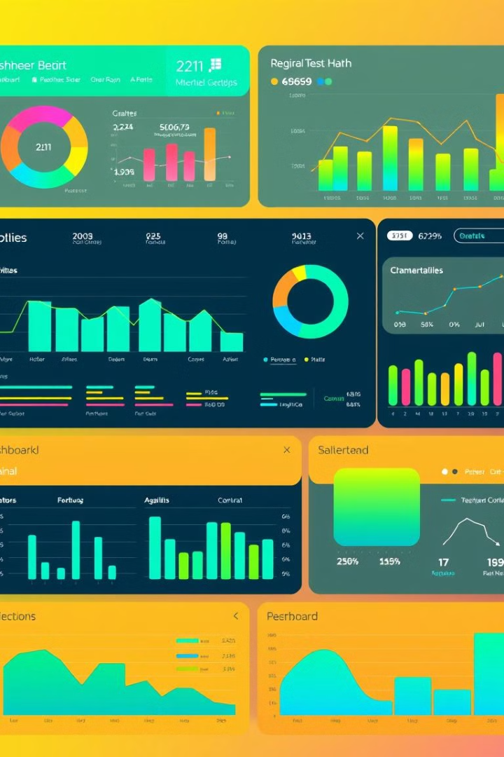
Project Goals: Defining Success Metrics
1
Deployment Frequency
2
Lead Time for Changes
Measure the rate of successful deployments to gauge automation's impact on agility.
Track the time from code change to production deployment to assess efficiency.
3
System Reliability
Analyze the frequency and duration of outages to assess automation's impact on stability.

Slide 4
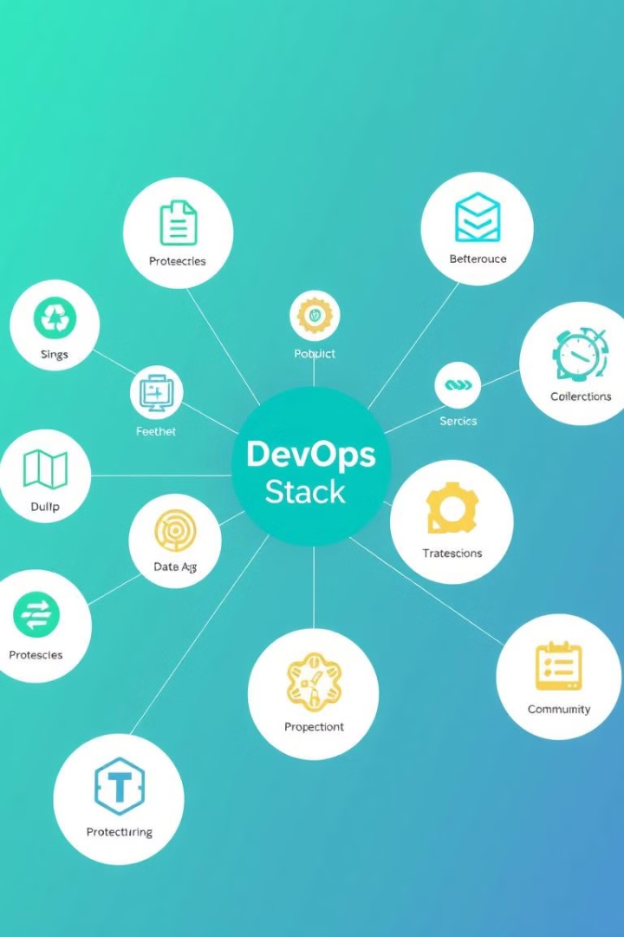
Automation Technologies Deployed: A Quick Tour
Jenkins
Continuous integration and delivery pipeline automation.
Terraform
Infrastructure as Code (IaC) for automating infrastructure provisioning.
Kubernetes
Container orchestration for managing and scaling containerized applications.
Prometheus & Grafana
Real-time monitoring and visualization for performance and health insights.

Slide 5
CI/CD Pipeline Performance: Before and After
Before Automation
After Automation
Manual deployments were time-consuming, error-prone, and lacked consistency.
Automated pipelines enabled faster, more frequent, and reliable deployments.

Slide 6

Infrastructure as Code (IaC) Impact on Speed & Stability
Manual Infrastructure
1
Time-consuming and prone to errors due to manual configuration.
2
IaC Automation
Faster and more reliable deployments with consistent infrastructure configuration.

Slide 7
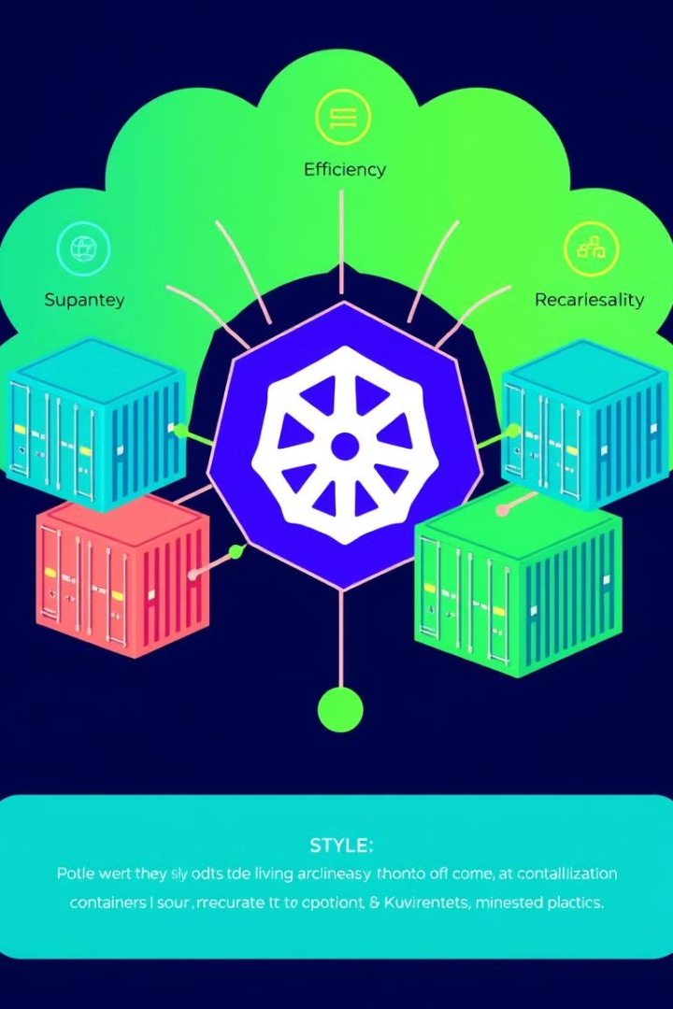


Containerization and Orchestration Efficiency Gains
Containerization
Orchestration
Package and deploy applications with their dependencies in isolated containers.
Automate container deployment, scaling, and management across a cluster.

Slide 8
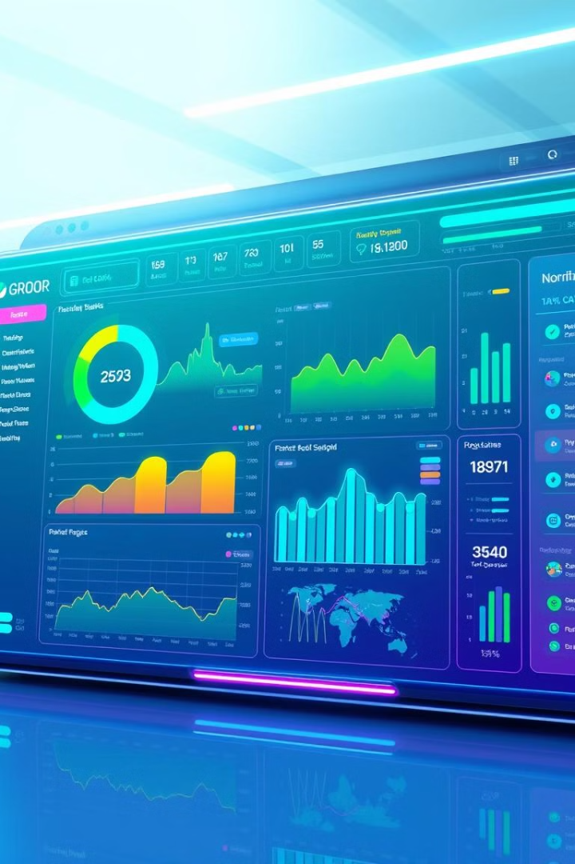


Real-time Monitoring: Prometheus & Grafana in Action
Prometheus
Collects real-time metrics from applications and infrastructure.
Grafana
Visualizes Prometheus data for real-time performance monitoring and troubleshooting.

Slide 9

Data-Driven Results: KPIs and ROI
20%
50%
99%
Deployment Frequency
Lead Time
Uptime
Increased by 20% due to automated pipelines.
Reduced by 50% through IaC and containerization.
Improved to 99% with robust monitoring and automation.

Slide 10

Next Steps & Future Enhancements
Expand Monitoring
Integrate additional metrics for deeper insights and proactive problem-solving.
AI-Driven Automation
Explore AI capabilities for intelligent automation and predictive analytics.
DevOps Culture
Foster a culture of continuous improvement and collaborative innovation.

